Slide 1
5G Technology
The new generation of internet that is going to create a new generation of the world !!

Slide 2
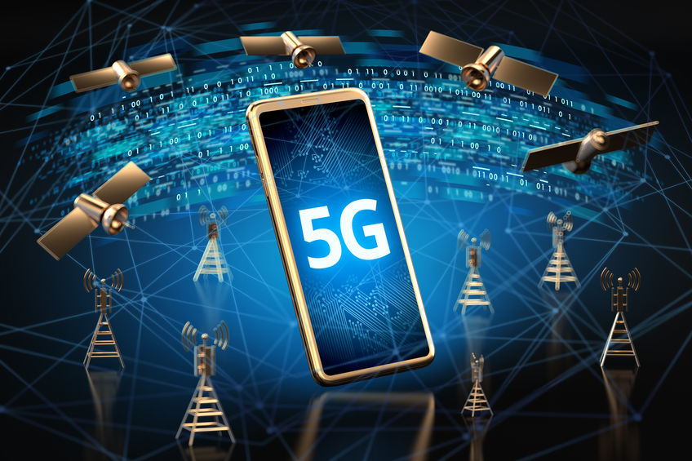
What is 5G technology ?
It is the latest iteration and the fifth generation of cellular internet technologies.
It is evolved after rigorous research and development and high-end innovations.
5G is a new realm on the internet technology and is several times better than the previous generations, both qualitatively and quantitatively.

Slide 3
1G vs 2G vs 3G vs 4G vs 5G:
Quantum computing is a rapidly-emerging technology that harnesses the laws of quantum mechanics such as superposition, entanglement, interference etc., to solve problems too complex for classical computers.
Classical computers works on Binary Bits ( 0s and 1s ) while Quantum computers works on Quantum Bits also known as “Qubits”.
Qubits can be 0, 1 as well as both together i.e., a superposition of 0 and 1. A Qubit can be both 0 and 1 at the same time, till the time it is observed !!
This property of the Qubit to be in a superposition of 2 states at the same time is what provides the Quantum Computers with exponential speedup when compared to Classical Computers.

Slide 4
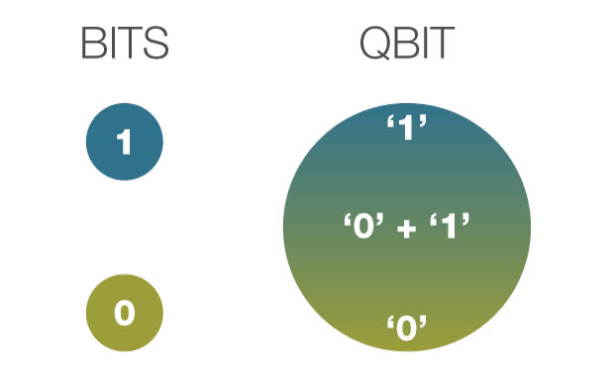
Qubits & Superposition

Slide 5
Superposition

Slide 6
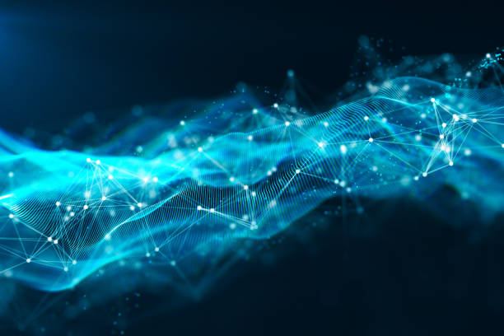
Entanglement:
It is the property that says that the states of entangled qubits cannot be described independently of each other.

Slide 7

Quantum physics is both confusing and mind blowing !!

Slide 8
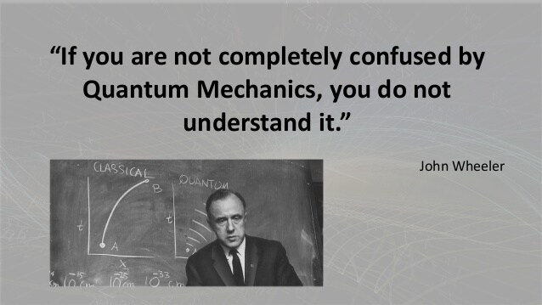
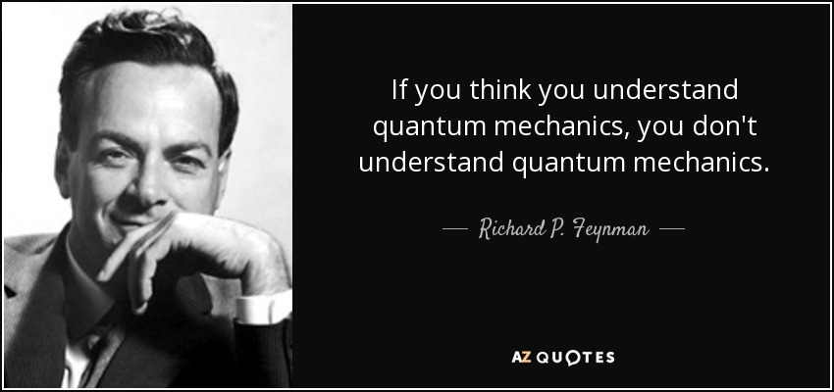

Slide 9
Need for Quantum computers:
To solve highly complex and extremely exponential problems that cannot be solved by classical computers.
Problems like optimization, NP hard problems etc.,
Simple examples: 10-member round dining table, travelling salesman, finding longest routes, chess board and rice problem etc., ( 2^64 = 18,446,744,073,709,551,616)
Sycamore is a quantum processor developed by Google. It has 53 qubits.
In 2019, Sycamore completed a task in 200 seconds that Google claimed, would take a supercomputer 10,000 years to finish.

Slide 10
Why is Quantum computer so powerful ?:
For a parallel computer and similarly super computers, we need to have one billion different processors.
In a quantum computer, all one billion computations will be running on the same hardware at the same time. This is known as quantum parallelism.
Quantum parallelism is used to perform a very large number of computations at the same time, and quantum interference is used to combine their results into something that is both meaningful and can be measured according to the laws of quantum mechanics.

Slide 11
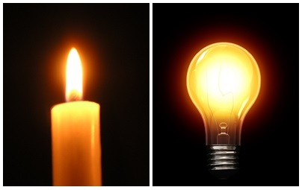
Quantum Computers are not Super Computers !!

Slide 12
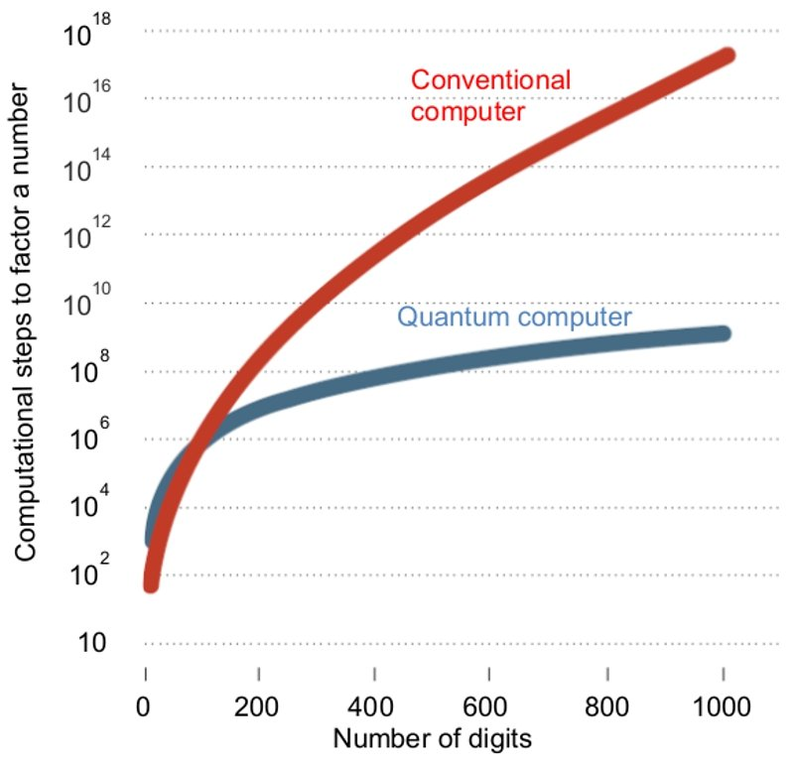
Performance comparison:

Slide 13
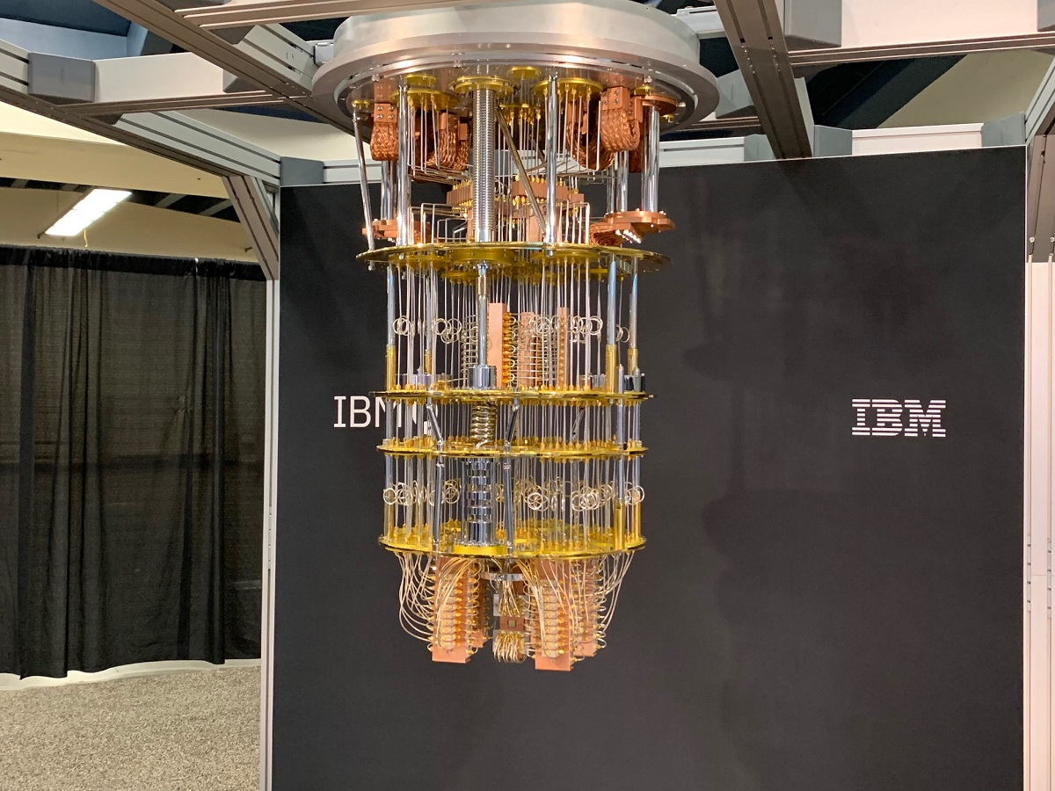
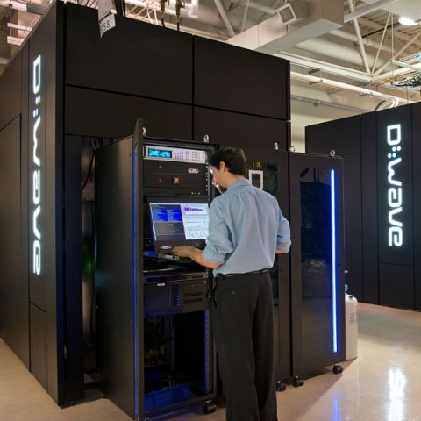
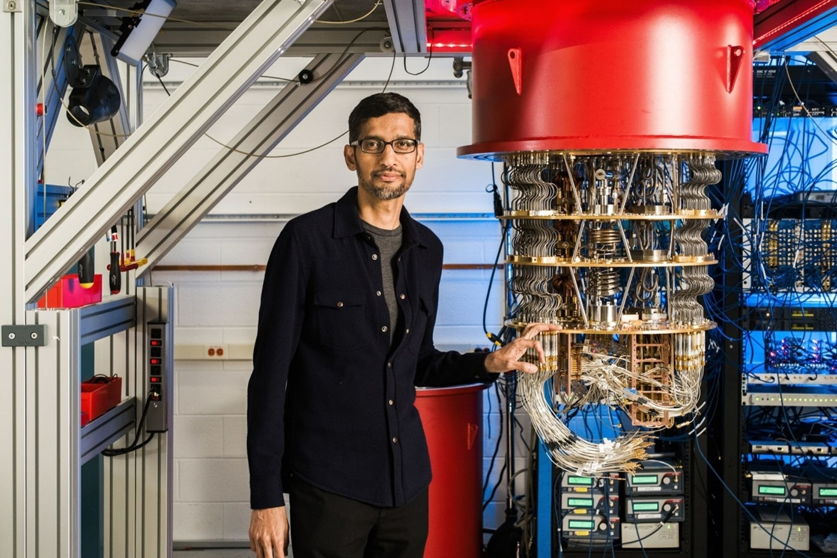
Examples:

Slide 14
Applications of Quantum Computing:
Climate and weather: prediction of bad weather can be done effectively and better climate models and climate-human interaction can be studied.
Molecular structure simulation.
AI and ML applications.
Defense applications like semi automated military aircrafts.
Cryptography and Cyber security: quantum-based encryption can be designed which cannot be broken by any of the conventional high-end hackers.

Slide 15
Drug development:
Chemists test tons of different molecular combinations to find one that actually has properties that are effective against a disease. This process can take years and cost millions of dollars. Chemists bring tons of these combinations to later-stage trials and many of them still end up failing.
A quantum computer would be able to map out trillions of molecular combinations and quickly identify the ones that would most likely work, significantly cutting down the cost and the time of drug development.
Genetic studies:
Quantum computing could also sequence and analyze a person's genes much faster than the methods we have now, and that could also help make personalized drugs and healthcare more available to the masses.

Slide 16
Data Analytics:
sort through mountain of data much faster than a regular computer or a human could, and it could point us to which images and videos we should take a closer look at and which ones we can just ignore and throw out.
streamline both air traffic and ground-based traffic control because they're so good at quickly calculating the optimal route.
A quantum computer could tackle more data in any given telescope view, spot more exoplanets, and help quickly identify which ones have the most potential to harbor life. It could even uncover exoplanets that Kepler space telescope missed during its first run through older images.

